Slide 1



SpaceX Falcon 9 Data Insights
SpaceX Falcon 9 rocket launches prediction for cost estimate

Slide 2

Summary
This presentation provides the prediction if the Falcon 9 first stage will land successfully. SpaceX advertises Falcon 9 rocket launches on its website with a cost of 62 million dollars; other providers cost upward of 165 million dollars each, much of the savings is because SpaceX can reuse the first stage. Therefore if we can determine if the first stage will land, we can determine the cost of a launch. This information can be used if an alternate company wants to bid against SpaceX for a rocket launch.
1 | Data Collection
2 | Data Analysis
3 | Data Visualization
4 | Data Prediction
5 | Data Findings
6 | Conclusion

Slide 3
Introduction
Python code to manipulate data in a Pandas data frame
Data science methodologies to define and formulate a real-world business problem.
Data analysis tools to load a dataset, clean it, and find out interesting insights from it.
Data Visualization tools for visualizing data
Data Interactive visualization plotly dash module
Data Predictions using python machine learning sklearn module.

Slide 4
Data Collection
Collected data from rocket launch data from SpaceX API and decode the response content as a Json using .json() and turn it into a Pandas dataframe using .json_normalize()
WebScrapping and APIs used in collecting data into desired format .
Data Wrangling is performed to remove missing values by using mean() and replace() functions
Finally,Data Frame is ready for the Data Analysis
Github link for the datascience capstone

Slide 5
Exploratory Data Analysis with SQL
Using python Sqlalchemy and Sqlite functions,created data base and table for SpaceX Launches data and queried to data base to get information
Displayed the unique launch sites with Distinct() method
Displayed 5 Launch records beginning with 'CCA' with WHERE and LIKE
Calculated total Payloadmass carried by boosters launched by NASA with SUM()
Calculated average payload mass carried by booster F9 v1.1
Displayed successful landings,Failures,specific dates for particular Landings.
GITHUB LINK

Slide 6
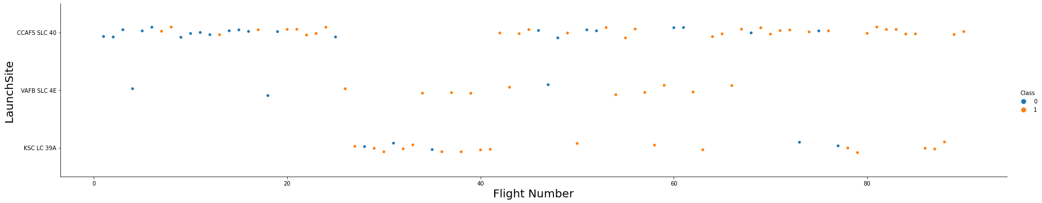
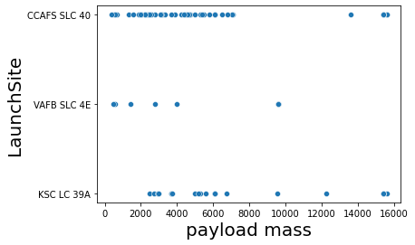
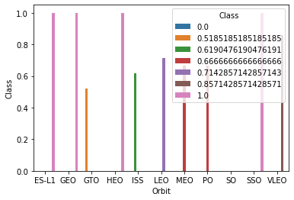
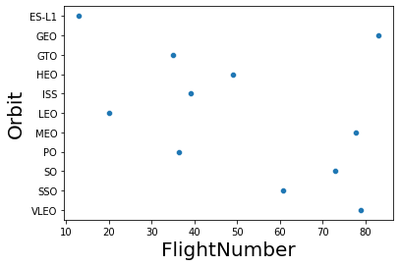
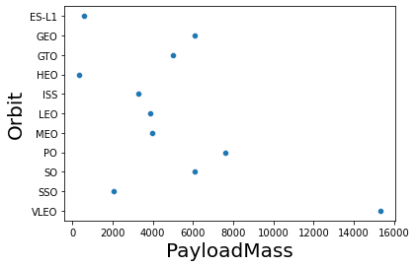
Data Visualization
Using Matplotlib.pyplot and seaborn Visualization Python modules ,created above visualization graph to find the relationship between different features of SpaceX data.

Slide 7
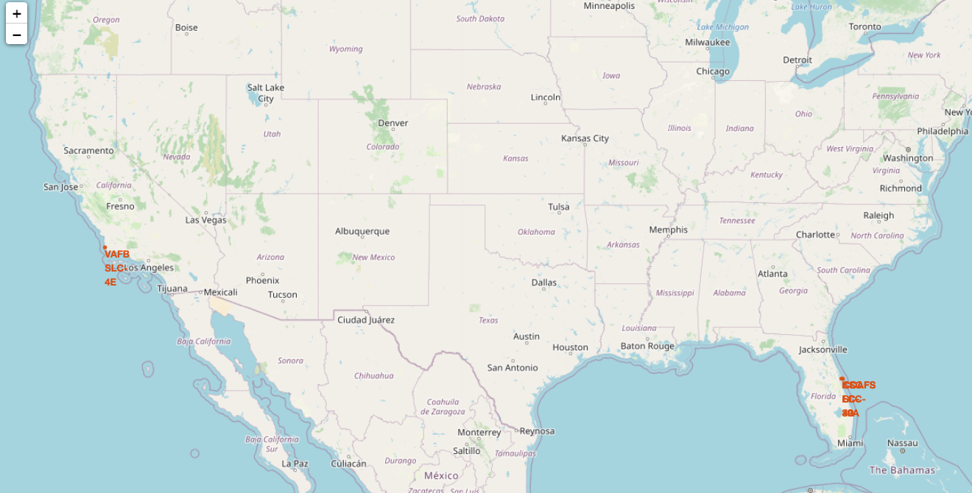
LAUNCH SITE MARKES

Slide 8
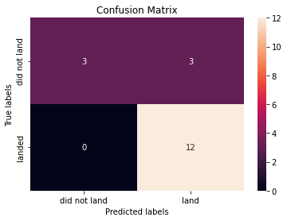
Data Predictions
Started Predictions using sklearn python machine learning module
Stardadized the data using StandardScaler.fit_transform() function
Split the data into training and testing data using train_test_split() function
LogisticRegression is used to find the best fit of the model and got 84% accurancy with this model using score parameter.
Got the Confusion matrix for LogisticRegression.

Slide 9
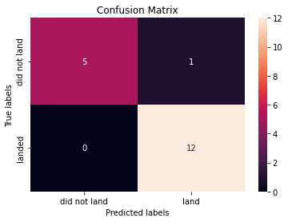
Data Predictions
Using SupportVectorMatrix for data predictions ,tuned hyperparameters and got accurancy scores with best_params_ and best_score_
Got 95% accurancy on test data.
Got Confusion Matrix for SVM.

Slide 10
DecisionTreeClassifiers and K Nearest neighbour prediction algorithms are used to predict on test data . Conclusion: We Concluded our Data Prediction with the above findings.
Data Predictions
Datascience capstone project link

